Slide 1
9th International Symposium on Recent Advances in Food Analysis (RAFA)
Jason Xu, Fanzhou Kong, Guangtao Zhang
Nov. 5-8, 2019, Prague
Notes:
1

Slide 2
Content
RAFA overview
Research highlight
Mars Activities
Identification of leading expert

Slide 3


RAFA review
Featured topics
Contemporary trends in Analytical & Bioanalytical strategies in Food quality and safety control
Challenges / novel approaches in food and natural products analysis
800+ participants from 60 countries
Industry, regulators, academia, etc.
Mycotoxin
Migrants from food contact materials
QA/QC & Chemometrics & Big data handling
Authenticity & Food fraud
Microplastics in Food

Slide 4
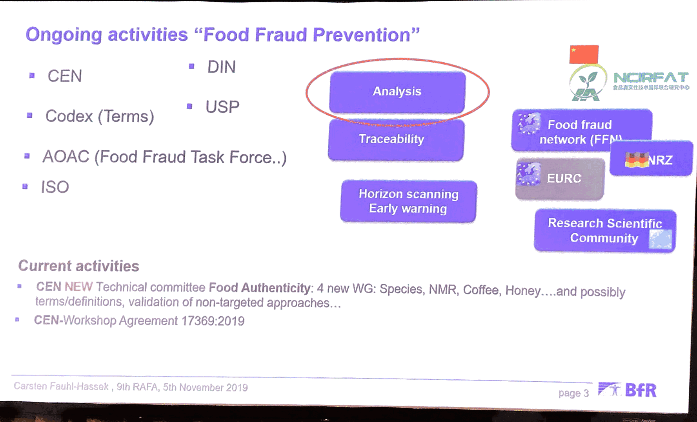
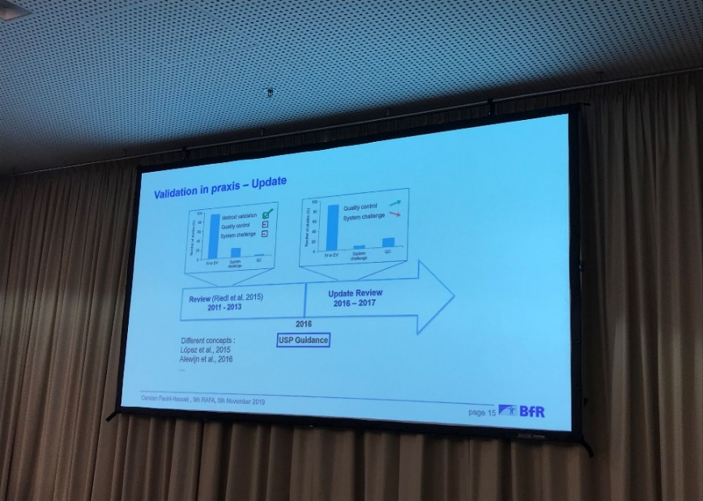
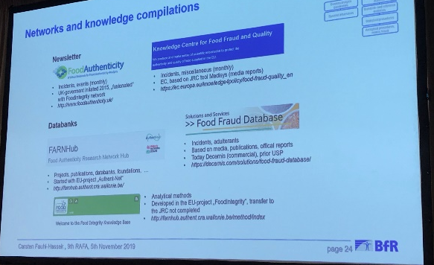
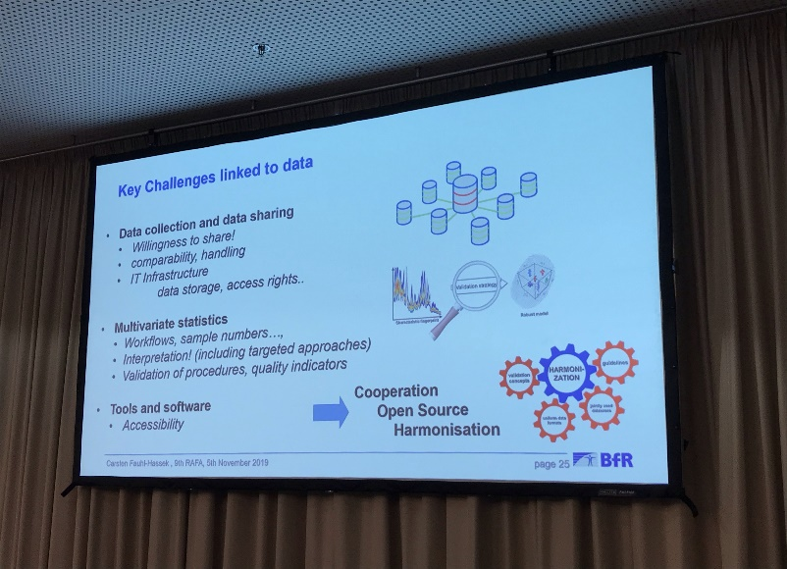
Research highlights - Food authenticity
Key challenges in analytical authentication
Carsten Fauhl-Hassek （83@bfr.bund.de）
German Federal Institute for Risk Assessment (BfR)
Three Analytical approaches for authentication were introduced
CEN* workshop Agreement (CWA 17369:2019): Authenticity and fraud in the feed and food chain. Concept, terms, and definitions
Who is active in the area of Food Fraud Prevention: CEN, Codex, USP, AOAC, etc.
Take home message:
Four factors are essential for the success of analytical authentication;
a. DoE: representative sample set
b. Complexity of requirement
c. Consistent data base
d. Standardized evaluation criterions
Critical references that need attention : CWA, USP Guideline, “Food Authent”, etc.
*CEN: the European Committee for Standardization

Slide 5
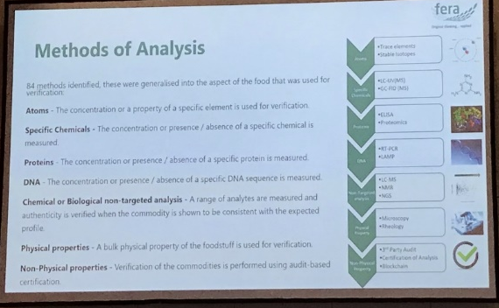
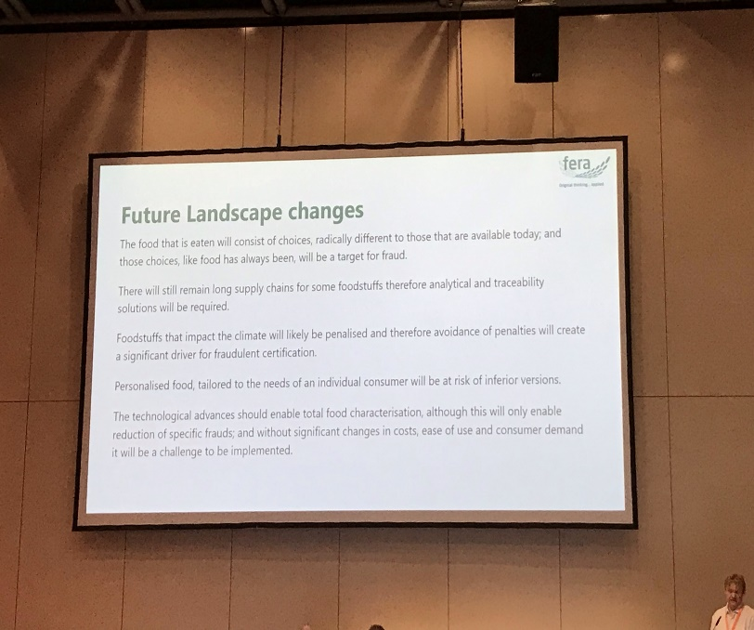
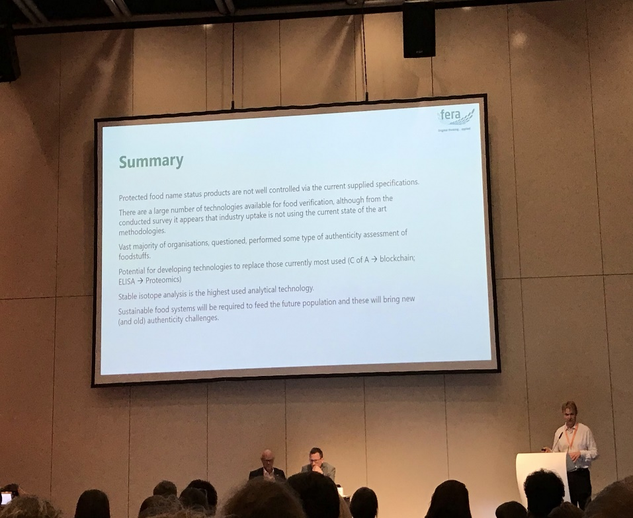
Research highlights - Food authenticity
Review of analytical methods, horizon scanning and capabilities for food authenticity
James Donarski (James.Donarski@fera.co.uk)
Fera Science Ltd
According to the survey , it was found that the industry is not using the current state of the art methodologies for food verification Several future trends that will impact the development of food authentication:
Rapid changing demographics
Rapid urbanization
Tech. advancement
Lack of resources and climate change
Take home message:
According to the review, protected G.I. status are not well controlled
We need to be aware of the technological evolution：e.g. from CoA to blockchain, from ELISA to Proteomics
New authenticity challenges will rise with the development of sustainable food system

Slide 6
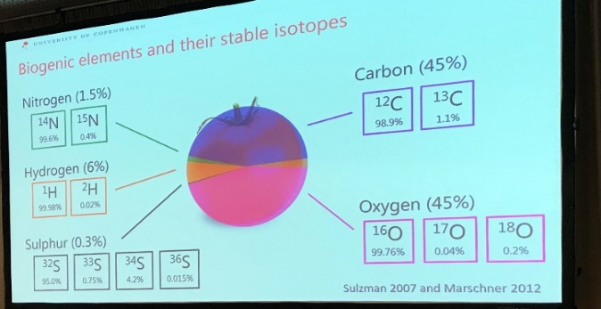
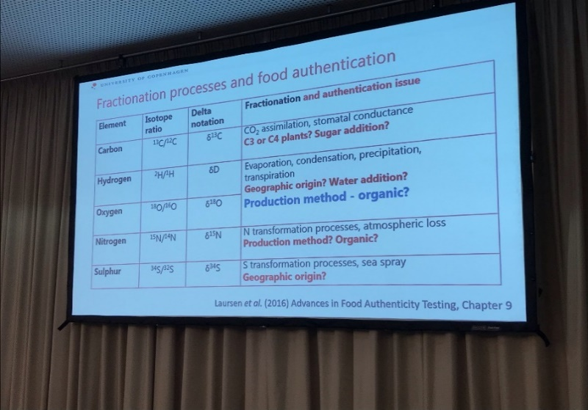
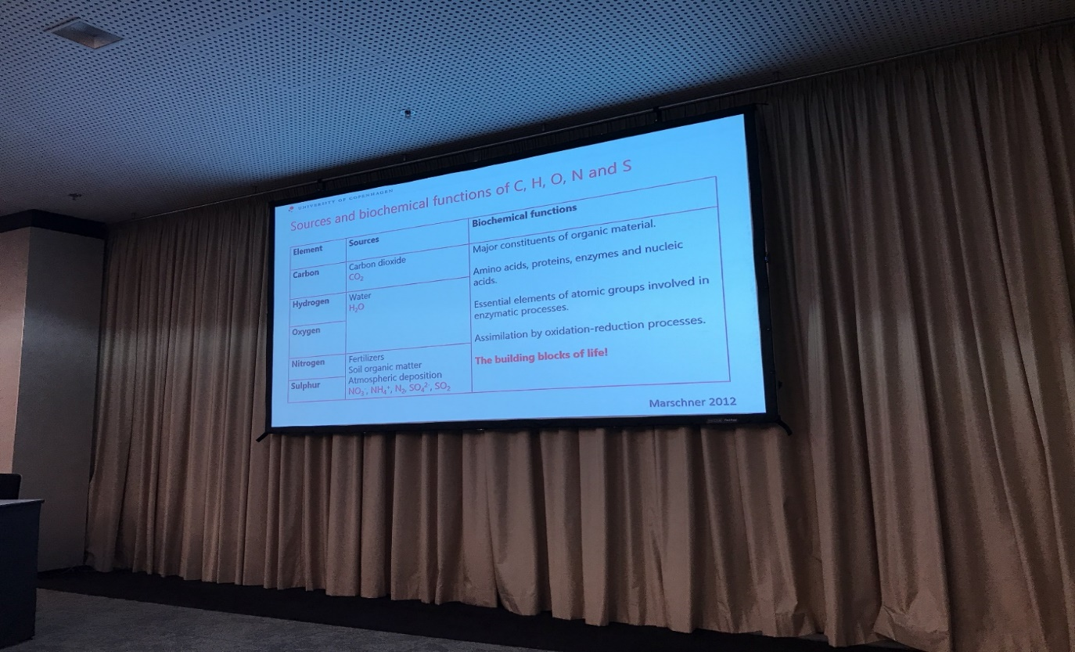
Research highlights - Food authenticity
Key factors controlling stable isotope signatures of plant-based foods
Kristian Holst Laursen (holst@plen.ku.dk)
University of Copenhagen
Introduction of sources and biochemical functions of C, H, O, N and S;
Introduction of fractionation process and food authentication: e.g. How ³⁴ S/ ³² S could indicate the geological origin
Take home message:
Plants contain stable isotope signature, reflecting their environment; also, the agrowth history of plants if recorded in the stable isotope profile.
Compound-specific isotope analysis is a powerful analytical tool for authenticity testing,
Notes:
What is the conclusion?

Slide 7
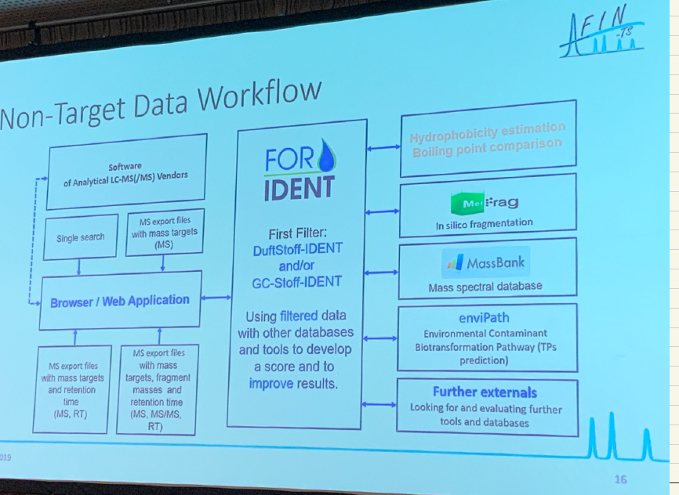
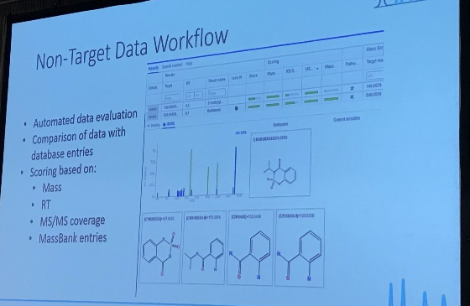
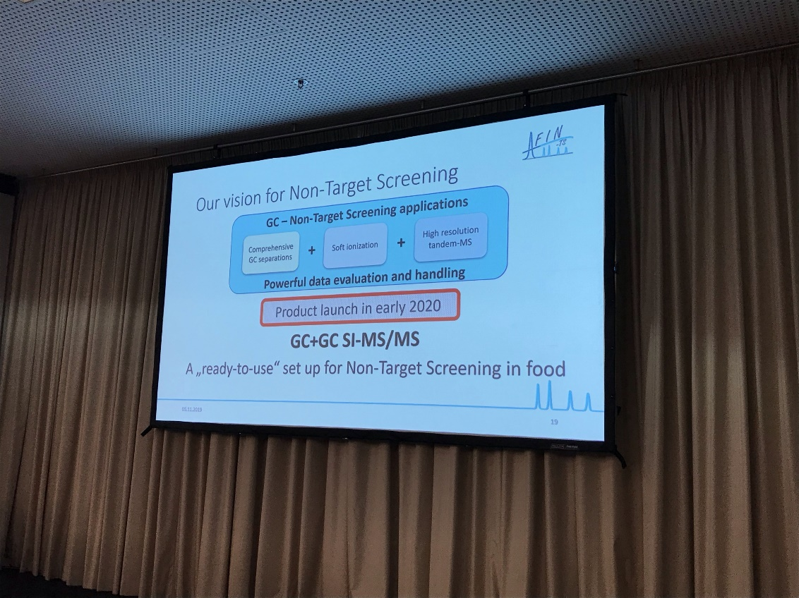
Research highlights - Food authenticity
Paradigm shift in non-target screening with GC-MS (/MS): Food analysis using soft ionization, statistical workflows and compound databases
Stefan Bieber,
Analytical Research Institution for Non-Target Screening GmbH, Augsburg, Germany
Three factors contributing to efficient non-targeted screening: a. comprehensive separations b. sensitive detection c. robust data evaluation
Challenges: the more steps (e.g. sample prep. and separation by GC), the more sample (information) will be lost
Comprehensive GC separation + soft ionization + High resolution tandem-MS = A “ready-to-use” set up for Non-Target Screening in Food
Take home message:
Above mentioned set-up will be commercially available in early 2020
A-FIN (https://afin-ts.de/) provide consulting and service for non-targeted screening and related data evaluation strategies;
A-FIN also provides services on method development for supercritical fluid chromatography (SFC)
Notes:
Soft ionization related
MALDI.

Slide 8
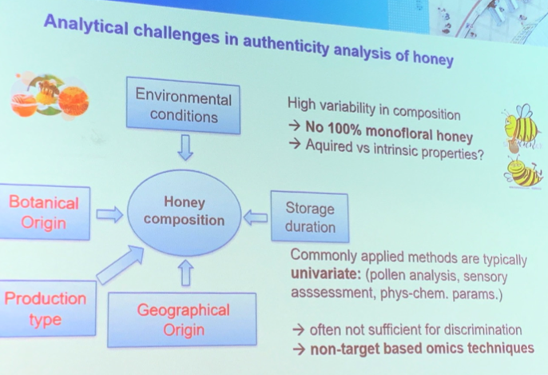
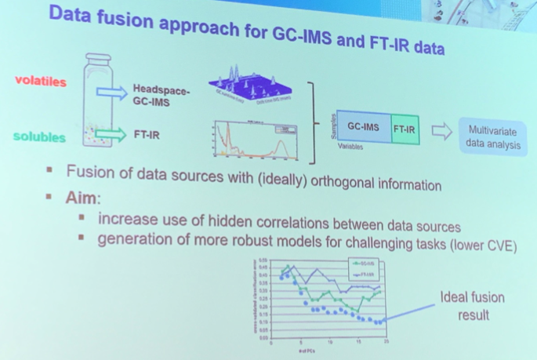
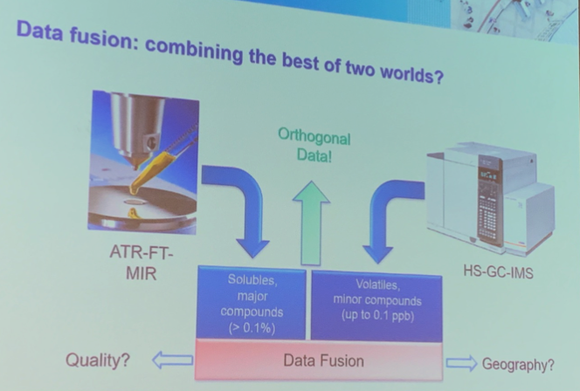
Research highlights - Food authenticity
Data fusion of GC-IMS data and FT-MIR spectra for the authentication of olive oils and honeys- is it worth to go the extra mile?
Philipp Weller (p.weller@hs-mannheim.de)
Mannheim University of Applied Science
This study aims to address analytical challenges in authenticity and traceability of honey
After combining data from orthogonal data sources (e.g. GC-IMS for “volatiles”, ATR-FTIR for ”soluble”), significant boost of classification accuracy was observed: FT-MIR or GC-IMS along has accuracy of 98.46% and 92.31%, respectively; by using data fusion, the accuracy boost up to 100%
Take home message:
Complex tasks may benefit from orthogonal data sources in food authentication studies
With good preprocessing, clear understanding of the data and strict validation process, data fusion can help to make use of hidden information
The knowledge gained in this study could be potentially transferred in authenticity study of commodities other than honey

Slide 9
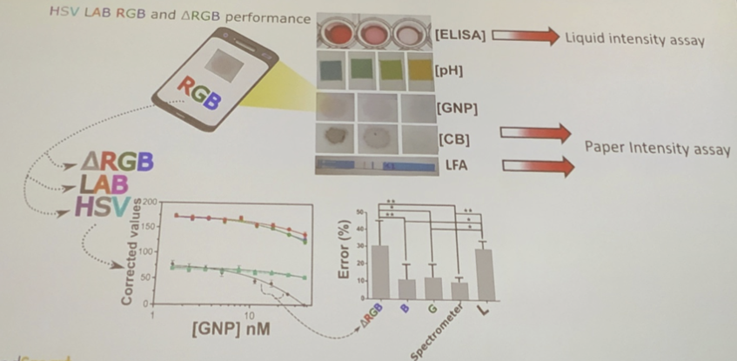
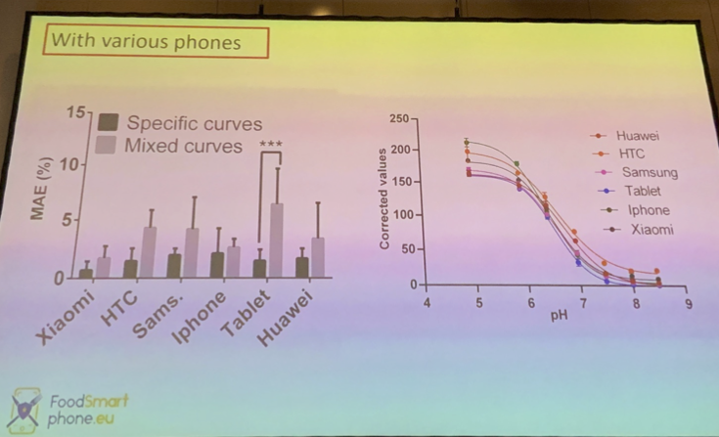
Research highlight - Portable equipment
The omniphone: one smartphone app for universal colorimetric analyses using a randomized combined channel approach and machine learning
Joost Laurus Dinant Neils (J.Nelis@qub.ac.uk)
Queen’s University Belfast
By using camera on smart phone, different colorimetric assays (ELISA, pH, GNP, CB and LFA) can be measured out of the lab
Smartphone outperforms the benchtop spectrometer in terms of sensitivity, making it a potential tool for spectrometer alternative
However, there are significant variations between phone brands, making this method not as reliable as benchtop devices
Take home message:
This technology is really promising but still under development and further optimization is needed before industry application
We should keep monitoring this technology make use of it whenever it is ready

Slide 10
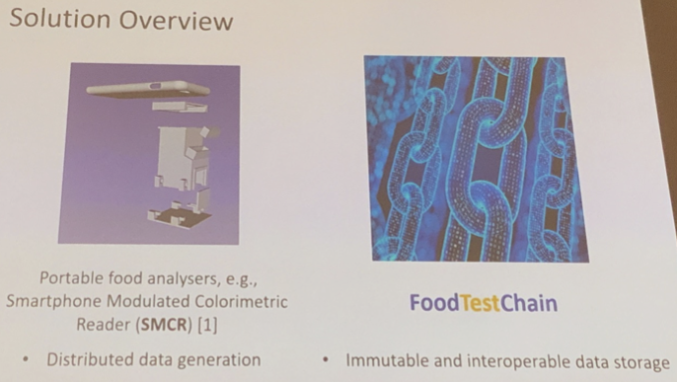
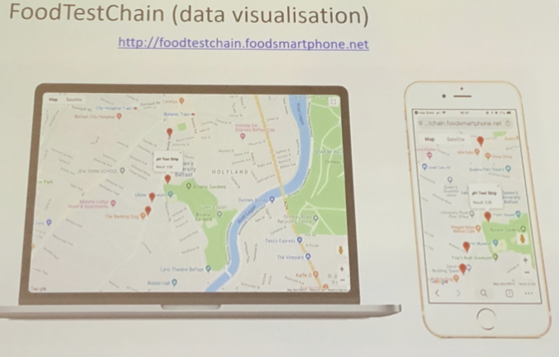
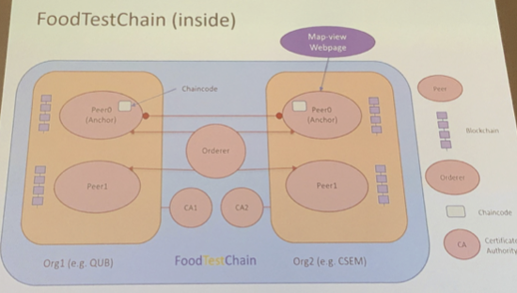
Research highlight - Portable equipment
Foodtestchain: interoperable and immutable food diagnostic data via blockchain
Yunfeng Zhao (y.zhao@qub.ac.uk)
Queen’s University Belfast
Portable food analyzers (e.g. omniphone) coupled with block chain technology provides solution to prevent food fraud in real-time
Customers will have a real-time data visualization for a specific food product including its color, pH and other parameters on mobile devices
The data once stored on the cloud is immutable and interoperable, leaving no room for adulteration
Take home message:
Blockchian is an emerging technology that draws a lot of attention recently; it has been deployed in a variety of industries already
The blockchain-based cloud data storage technology provides possible solution for raw material tracing in real-time within our value chain
y.zhao@qub.ac.uk
Notes:
Combine the background and
What does it solve?

Slide 11
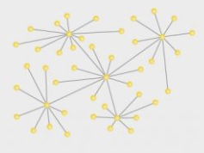

What is blockchain?
A blockchain is, in the simplest of terms, a time-stamped series of immutable records of data that is managed by a cluster of computers not owned by any single entity.
The nature of the blockchain technology prevents any modification made on the data stored on the "blocks". Once recorded, the data in any given block cannot be altered retroactively without alteration of all subsequent blocks, which requires consensus of the network majority, granting blockchain the property of decentralization
There are two types of blockchian in gerenal: permissionless blockchain (bitcon), and permissioned blockchain (FoodTestChain). Permissioned blockchain monitors the data change by a selected group instead of the public, thus tends to be more scalable and faster than permissionless blockchain, but more centralized
More about the blockchain and Mars ` work. (GT)
Permissioned blockchain
Permissionless blockchain

Slide 12
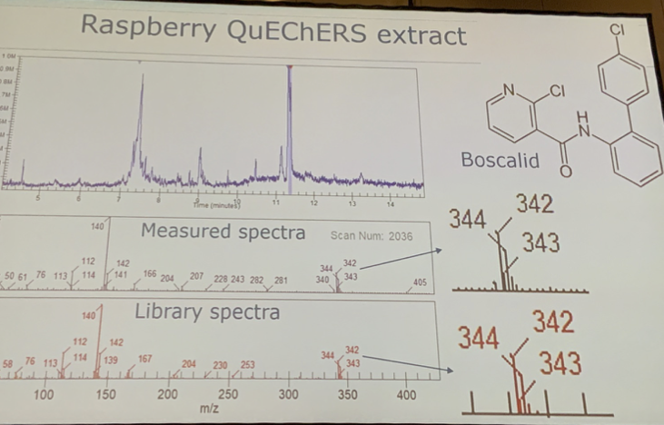
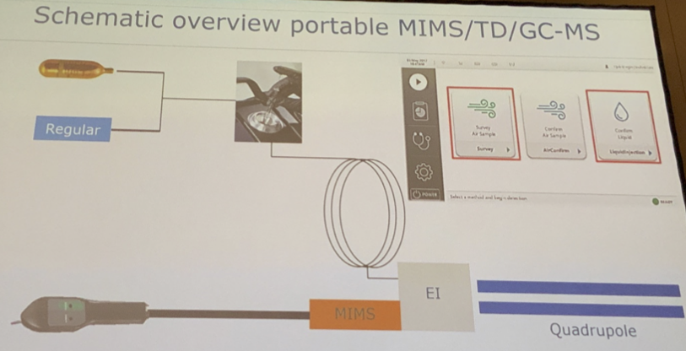
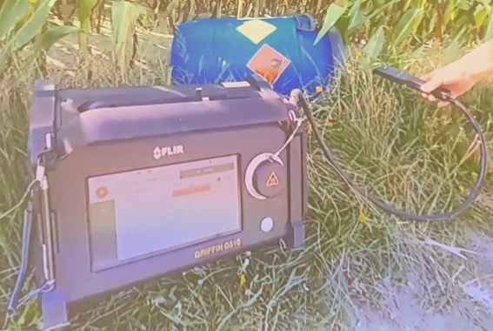
Research highlight - Portable equipment
True mobile mass spectrometry for on-site analysis of food contaminants
Macro Blokland (marco.blockland@wur.nl)
Wageningen Food Safety Research
The mobile MS provides on-site food forensics with three modes available: sniffing, thermal desorption and liquid extracts for versatility
This system has been tested to detect pesticide residue Boscalid the spectra matched with standardized library
This device will be retailing about 90,000 euros but it has not been made commercially avaliable yet; however, it is still significantly cheaper than benchtop GC/MS
Take home message:
This is one of the few portable operating GC-MS which competency has been validated.
Mars could utilize this for on-field study globally since it can fit in a regular suitcase
The cost is a fraction of desk-top GC-MS, making it closer for industry and lab deployment

Slide 13
Research highlight - Toxins and allergens (GT)

Slide 14
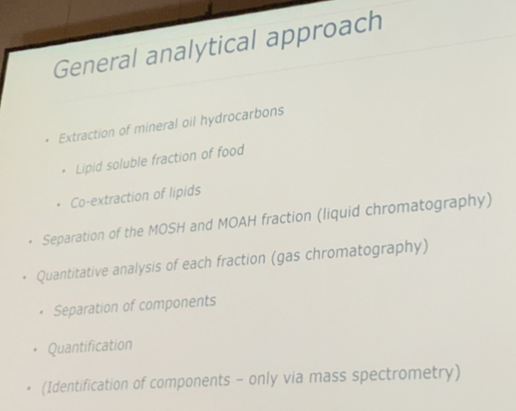
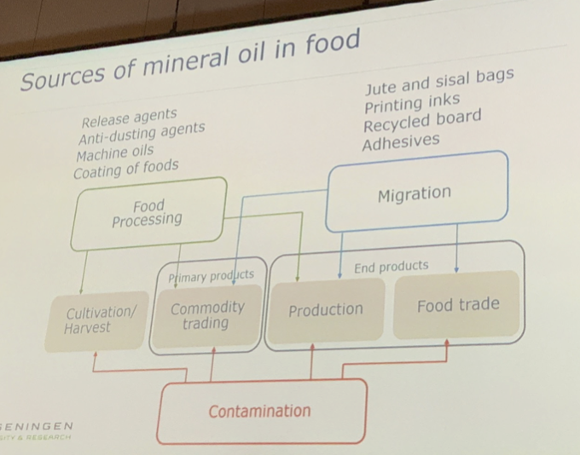
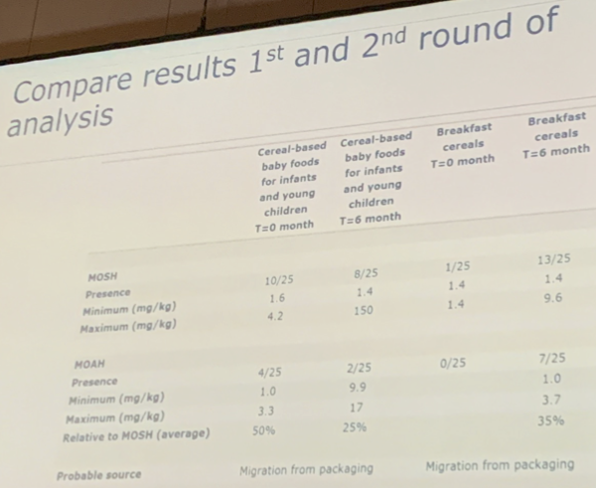
Research highlight – Food contaminants
Mineral oil hydrocarbons in the food chain
Ruud Peters (ruudj.peters@wur.nl)
Wageningen Food Safety Research
General analytical approach of mineral oil involves several steps of extraction and separation coupled with GC-FID
The origin of mineral oil contamination is complex and not yet elaborated
To elucidate one of possible contamination sources, which is food package migration, experiments were conducted for cereal-based baby food and cereal breakfast between a time interval of 6 months
Take home message:
The result showed that migration of mineral oil was observed in cereal-based foods over 6 months, implying package migration could be a potential source of mineral oil contamination for other food as well
ruudj.peters@wur.nl
Notes:
till 11/28/2019

Slide 15
Food Contaminates: TOFMS/FID for mineral oil analysis (GT)

Slide 16
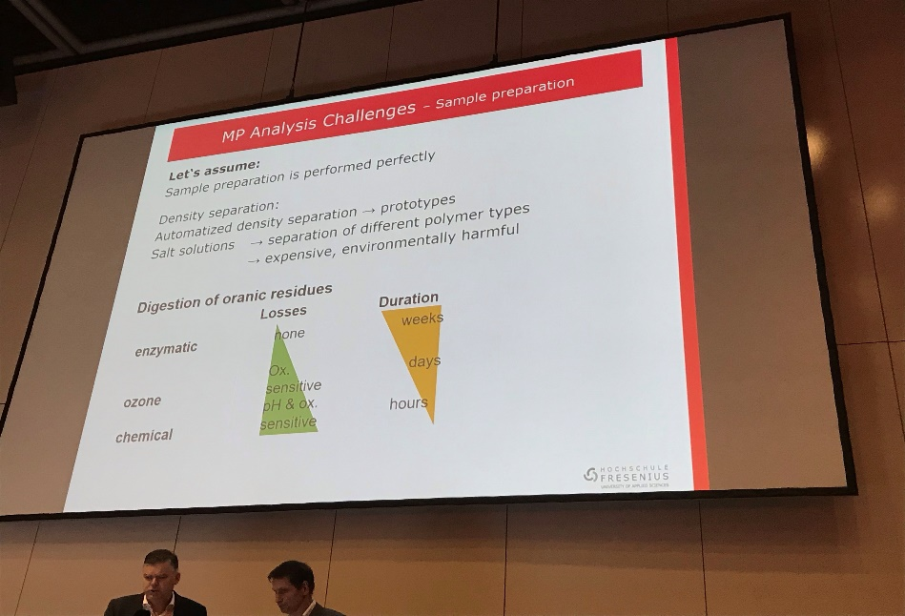
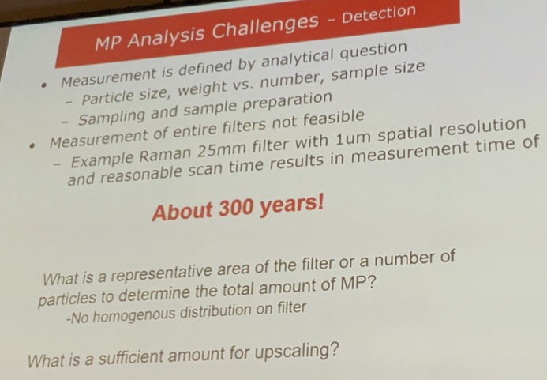
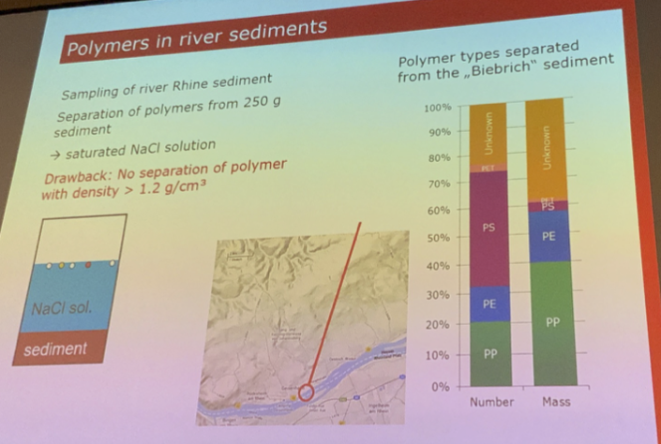
Research highlight – Food contaminants
The microplastics issue in the food chain, lessons learnt from water
Thomas P. Knepper (knepper@hs-fresenius.de)
Hochschule Fresenius
Microplastics refer to small plastic particles with size of often smaller than 5 mm, and accout significantly to the plastic pollution, especially in river and ocean
Major analytical methods avaliable are Infrared (IR) spectroscopy, Raman spectrosopy, Gel-permeation chromatography (GPC) and GC-MS (pyrolysis)
Recent studies have shown microplastic in food, German beer and toothbrush
In this study on Rhine river sediments, result showed that more than 50% of microplastic pollution is covered by polyethylene (PE) and polypropylene (PP)
Take home message:
Microplastic has raised public concerns and Mars should keep monitor it
And what else?
knepper@hs-fresenius.de

Slide 17
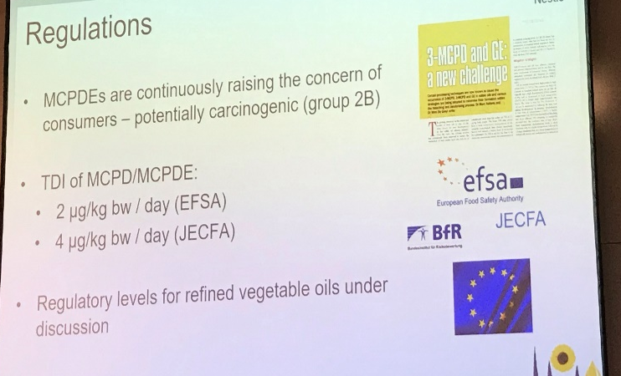
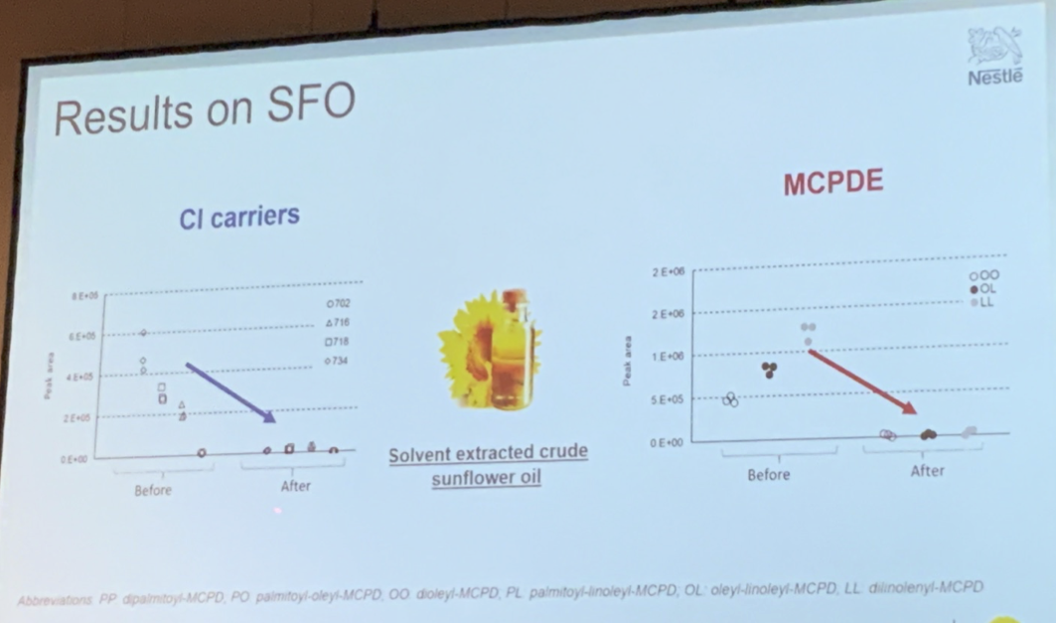
Research highlight – Food contaminants
A trapping approach to prevent the formation of MCPD in vegetable oils
Karine Redeuil (Kornel.Nagy@rdls.nestle.com)
Nestle Research
MCPD occurs in various vegetable oils during deodorization; its formation positively correlates with temperature
The goal of this research is to pick the best trapping agent and use it to prevent MCPD formation
LC & HRMS was implemented for in-house analytics
Take home message
Addition of polar trapping agent (monostearin) helps mitigating MCPD in some vegetable oils; acting at the early stage of oil refining process is efficient
More than one mitigation strategy is needed to successfully reduce the MCPD content in refined edible vegetable oil
This is the issue highly relavent to FSRM and SRA team, who should keep an eye on it
Kornel.Nagy@rdls.nestle.com

Slide 18
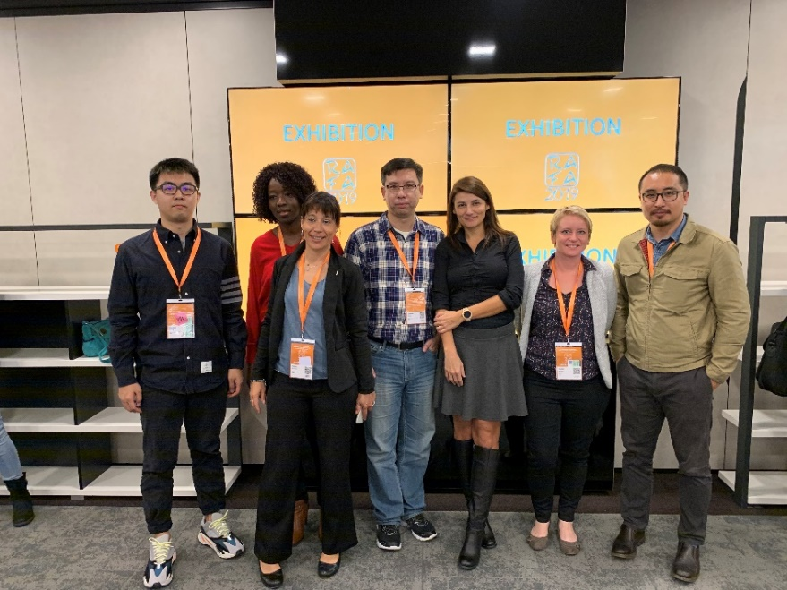
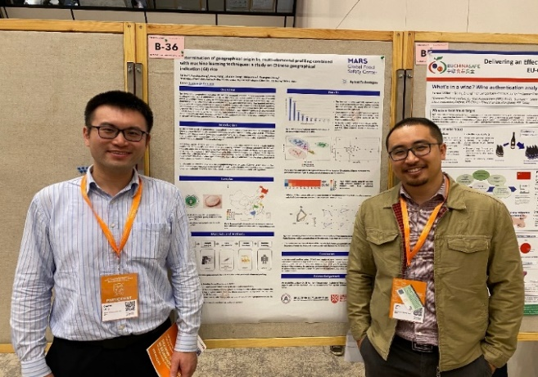
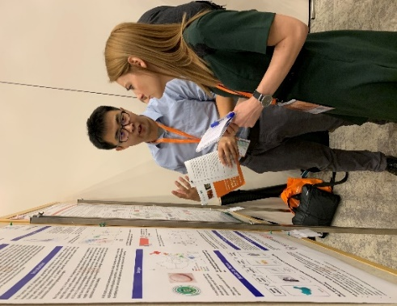
Mars activity
Jason Xu and Fanzhou Kong presented a poster on “rice fingerprinting”
Establish a reliable workflow to differentiate rice from different geographic regions in China.
Implementation of machine learning algorithms, random forest (RF) and support vector machine (SVM) for classification and reliefF for feature selection.
This study guides future work on rice authentication.
Stakeholder engagement
Networking with Mars MGS associates
Explore opportunities for potential collaboration
L: Jason Xu and Shuofei Dong (Agilent)
R: Fanzhou Kong explaining our poster to other researchers
Associates from GFSC and MGS Labs.

Slide 19
Identified experts and potential partners
Name | Affiliation | Expertise | Stakeholder follow-up
Vincent Baeten | Head of the Food and Feed Quality Unit, CRA-W | Vibrational spectroscopy, Chemometrics | GFSC
Carsten Fauhl-Hassek | Head of unit product identity, supply chains and traceability, BfR | Food integrity | GFSC
James Donarski | Head of Food Authenticity, Fera Science Ltd. | Stable isotope analysis, HRMS, NMR, proteomic and economics | GFSC
Philipp Weller | Head of Competency Center for Chemometric Analysis of Processes and Materials Mannheim University of Applied Science | Data analysis and food origin traceability | GFSC
Daobing Wang Shuangxi Fan | NCIRFAT (中国食品发酵工业研究院) | EU-China authentication project | GFSC
Zhuohong (Kenny) Xie | Scientific Liaison, US Pharmacopeia (USP) | Non-targeted methodology guideline | GFSC
Stefan Bindereif | Laboratory of isotope biogeochemistry, University of Bayreuth | Staple isotopic analysis | GFSC

Slide 20
Thank you
Mars Global Food Safety Center
www.marsgfsc.com

